Slide 1
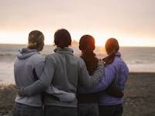
Week 3 Build friendships a state of mutual trust and support between people and communities
I wonder if you are a true friend?

Slide 2
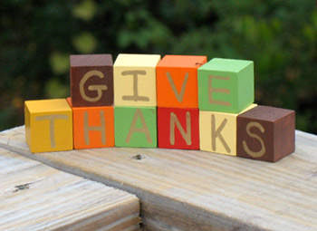
Let us pray The Lord is here / His spirit is with us

Slide 3
What sort of friend are you? Do you stick by your friends? Are you a true friend?
Proverbs 18:24
Friends come and friends go, but a true friend sticks by you like family.

Slide 4
Think about your friends - do they go to your school, football club, brownies?
Do you have a picture of them? If not, imagine them in your head.
As you think about each friend, think about one thing you really like about them.
I wonder what they might say about you?
As you hold the picture in your hand or head, thank God for each of your friends.
I wonder how you could build stronger friendships?

Slide 5
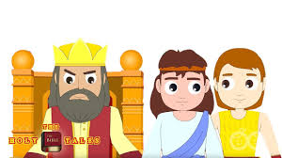
One of the most famous stories about friendship in the Bible is the story of Jonathan and David (1 Samuel 18-20). (Click the picture to watch the story)

Slide 6
Give praise though song Click on to the link.
https://www.youtube.com/watch?v=lldmkrJXQ-E
The More we get together. Younger children can join in this one!
https://www.youtube.com/watch?v=CNi02gxTI1M
A classic Friendship song from a family favourite – sing along.

Slide 7
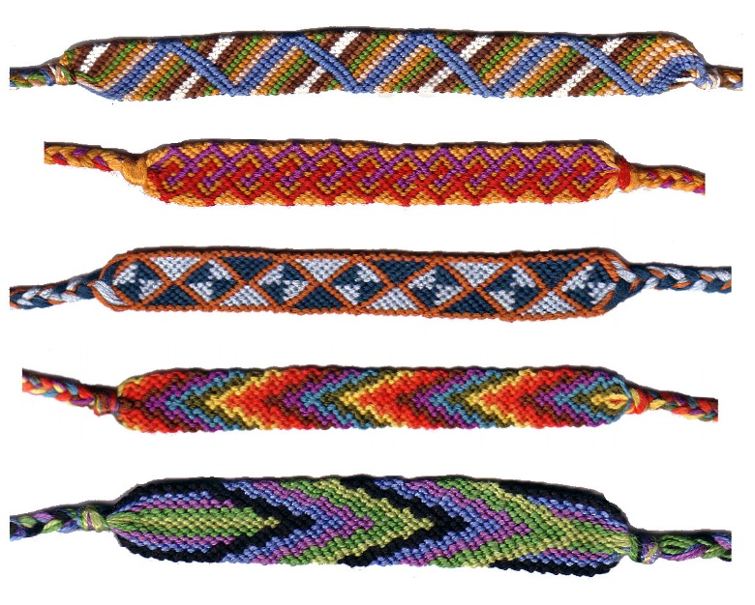
Show your Friendship
Why don’t you try and get in contact with some of your friends?
Could you send them a letter to tell them how much you appreciate their friendship?
Or send them an email via PurpleMash.
Send someone a card
Make a friendship bracelet for someone special.
Draw a picture of you and your friends….

Slide 8
May the Lord give us peace, love and thankfulness. Amen

