Slide 1
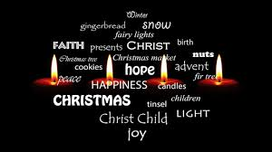
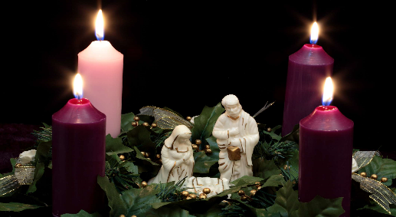
The Lord is here
His spirit is with us.
Preparing for Advent

Slide 3
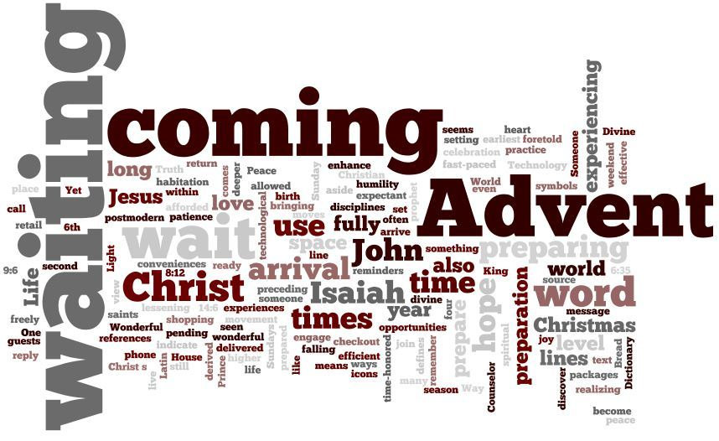

Slide 4
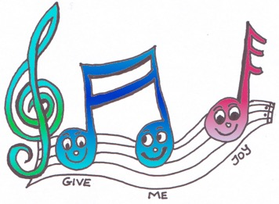
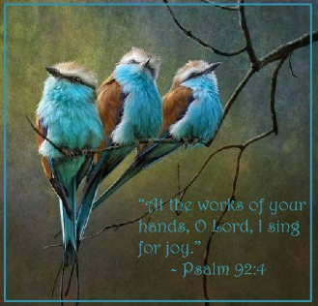
Lets sing and celebrate together.
https://www.bbc.co.uk/teach/school-radio/primary-school-songs-give-me-oil-in-my-lamp/zk9qwty
Give me oil in my lamp

Slide 7
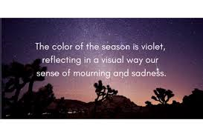
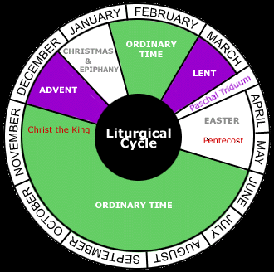
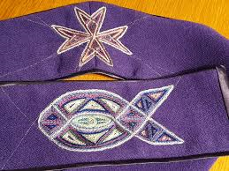
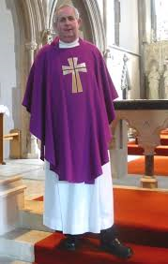

Slide 8
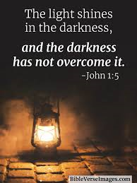
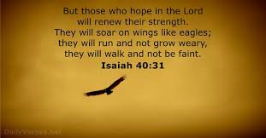
For in this hope we were saved. But hope that is seen is no hope at all. Who hopes for what they already have? But if we hope for what we do not yet have, we wait for it patiently.
Romans 8:24-25
1. God's people, The Candle of Hope.
2. The Old Testament prophets, The Candle of Peace.
3. John the Baptist, The Candle of Love.
4. Mary the mother of Jesus , The Candle of Joy.

Slide 9
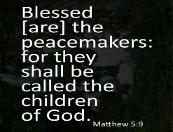
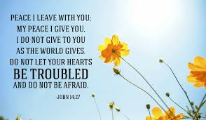
THE CANDLE OF PEACE John 14:27
Peace I leave with you; my peace I give you. I do not give to you as the world gives. Do not let your hearts be troubled and do not be afraid.
I wonder why peace was so important to Jesus and why he wanted to leave peace with his disciples?
I wonder why we see situations in school, in our community and around the world where peace is lacking?
I wonder why peace is not a natural part of the way in which people live and act?
I wonder if you have any ideas about how this could be changed?
Use this idea to model how to pray for peace:
https://www.christianaid.org.uk/resources/songs-syria-presentation
https://cafod.org.uk/Education/Primary-teaching-resources/Peace-liturgy

Slide 10
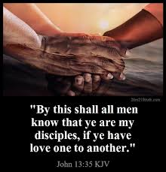
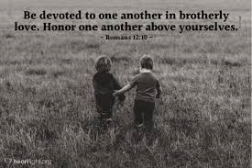
THE CANDLE OF LOVE John 13:35
By this everyone will know that you are my disciples, if you love one another.”
I wonder if you have shown that you love someone this week?
I wonder if you know anyone who is lonely or unhappy who especially needs your love just now?
I wonder what Jesus meant by his words in today’s Bible verse? Happy times of celebration can be a lonely time for many people, and a time when some people can feel stressed and unloved as they see others being happy and being loved

Slide 11
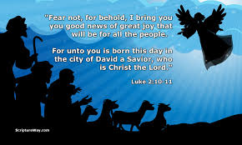
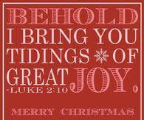
THE CANDLE OF JOY Luke 2:10-11
But the angel said to them, “Do not be afraid. I bring you good news that will cause great joy for all the people.
Today in the town of David a Saviour has been born to you; he is the Messiah, the Lord.
Although it is a while to go to Christmas, the message of the angels is one of the most joyful in the Bible (see verses above) and can be used to express the Christian joy at any time of the year.
I wonder what brings you joy?
I wonder how you seek to bring joy to others?

Slide 12
Let us say the words that Jesus gave us in prayer
Our Father in heaven, hallowed be your name, your kingdom come, your will be done, on earth as in heaven. Give us today our daily bread. Forgive us our sins as we forgive those who sin against us. Lead us not into temptation but deliver us from evil. For the kingdom, the power, and the glory are yours now and for ever. Amen.

Slide 13
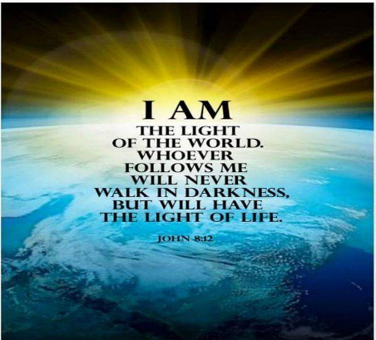
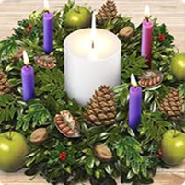
CELEBRATE John 8:12
Take time to celebrate the hope, peace, love and joy you have seen around the school this week

Slide 14
May the Lord grant us justice, truth and peace
And make this school a place of happiness
Amen

